Slide 1

The Azure Data Factory
Notes:
Primary Site: https://azure.microsoft.com/en-us/services/data-factory/
2-minute overview video: https://channel9.msdn.com/Blogs/Windows-Azure/Introduction-to-Azure-Data-Factory/

Slide 2

Azure Data Factory
Create, orchestrate, and manage data movement and enrichment through the cloud
Notes:
Learning Path: https://azure.microsoft.com/en-us/documentation/articles/data-factory-introduction/
Developer Reference: https://msdn.microsoft.com/en-us/library/azure/dn834987.aspx

Slide 3
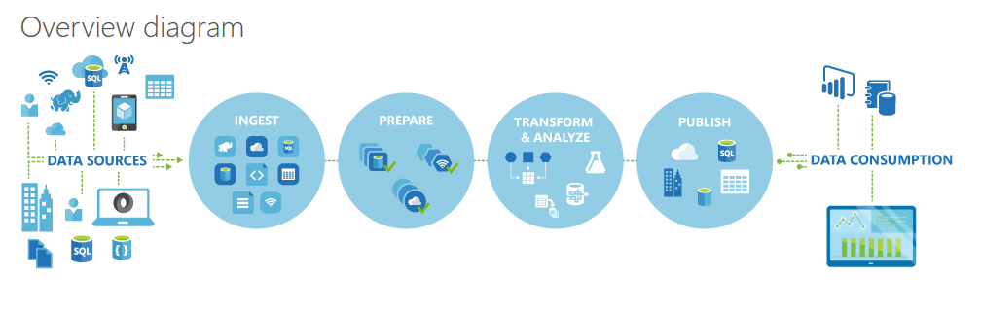
ADF Logical Flow
Notes:
Learning Path: https://azure.microsoft.com/en-us/documentation/articles/data-factory-introduction/
Quick Example: http://azure.microsoft.com/blog/2015/04/24/azure-data-factory-update-simplified-sample-deployment/

Slide 4
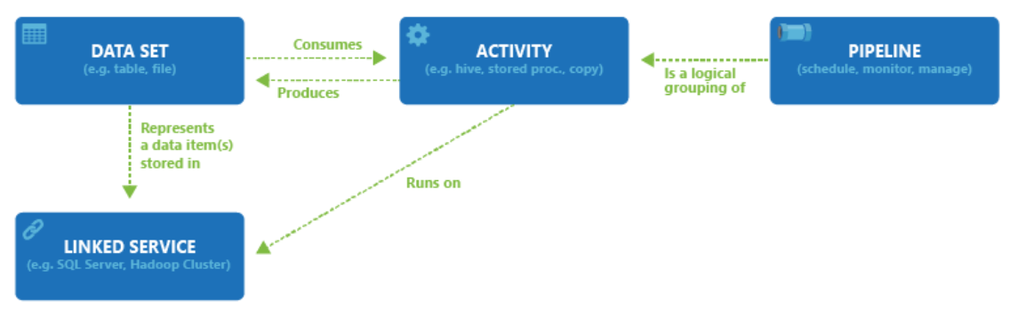
ADF Components
Notes:
Pricing: https://azure.microsoft.com/en-us/pricing/details/data-factory/

Slide 5
The ADF Process
Notes:
Primary Site: https://azure.microsoft.com/en-us/services/data-factory/
2-minute overview video: https://channel9.msdn.com/Blogs/Windows-Azure/Introduction-to-Azure-Data-Factory/

Slide 6
ADF Process
Define Architecture: Set up objectives and flow
Create the Data Factory: Portal, PowerShell, VS
Create Linked Services: Connections to Data and Services
Create Datasets: Input and Output
Create Pipeline: Define Activities
Monitor and Manage: Portal or PowerShell, Alerts and Metrics
Notes:
Full Tutorial: https://azure.microsoft.com/en-us/documentation/articles/data-factory-build-your-first-pipeline/

Slide 7
1. Design Process
Define data sources, processing requirements, and output – also management and monitoring
Notes:
https://azure.microsoft.com/en-us/documentation/articles/data-factory-customer-profiling-usecase/

Slide 8
Business Case
AdventureWorks is a company that makes and sells bicycles. The sales are conducted around the world. We also support our products. But as we’ve made more sales in the last 10 years, we’ve farmed out the support function to various companies that take in maintenance and support issues in call centers around the world.
We’re growing. And now we want to take our bicycles to several large retailers, but a few of them want to know a lot about our churn rate.
For over 10 years, we’ve collected a lot of information about our customers and of course we know a lot about our products. But since we’ve outsourced our call centers, we don’t own the databases that hold their data – they will give us an export, though. (They support multiple customers)
We’re not sure about our churn rate – we have the data of who has and has not bought again, and we think we can get the data from the call centers for the complaints and repairs, but we need a way to analyze a lot of data that has different formats to find a prediction of who will churn and who will not.
Ideally we want a list of customers we think will churn, in a structured database we could share out to our potential resellers sales staff, so they know how to target at-risk and new clients.
More on our in-house data: https://technet.microsoft.com/en-us/library/ms124501%28v=sql.100%29.aspx
Notes:
AdventureWorks Data Dictionary: https://technet.microsoft.com/en-us/library/ms124438(v=sql.100).aspx

Slide 9
Business Case
AdventureWorks is a company that makes and sells bicycles. The sales are conducted around the world. We also support our products. But as we’ve made more sales in the last 10 years, we’ve farmed out the support function to various companies that take in maintenance and support issues in call centers around the world.
We’re growing. And now we want to take our bicycles to several large retailers, but a few of them want to know a lot about our churn rate.
For over 10 years, we’ve collected a lot of information about our customers and of course we know a lot about our products. But since we’ve outsourced our call centers, we don’t own the databases that hold their data – they will give us an export, though. (They support multiple customers)
We’re not sure about our churn rate – we have the data of who has and has not bought again, and we think we can get the data from the call centers for the complaints and repairs, but we need a way to analyze a lot of data that has different formats to find a prediction of who will churn and who will not.
Ideally we want a list of customers we think will churn, in a structured database we could share out to our potential resellers sales staff, so they know how to target at-risk and new clients.
More on our in-house data: https://technet.microsoft.com/en-us/library/ms124501%28v=sql.100%29.aspx
Notes:
AdventureWorks Data Dictionary: https://technet.microsoft.com/en-us/library/ms124438(v=sql.100).aspx

Slide 10
HDInsight and the Hadoop ecosystem
Core Hadoop
Data processing
Microsoft integration
Data Movement
Packages
Pipeline / workflow
(Oozie)
JavaScript
C#, F#, .NET
Graph
(Pegasus)
Stats processing
(SparkR)
Machine Learning
(Mahout)
Data Integration
(ODBC / SQOOP/ REST)
Relational
(SQL Server)
Metadata
(HCatalog)
PDW Polybase
Real Time Processing (Storm)
NoSQL Database
(HBase)
Scripting
(Pig)
Query
(Hive)
Event Driven Processing
Distributed Processing
(MapReduce)
Event Pipeline
(Event Hub/ Flume)
Business Intelligence
(Excel, Power View, SSAS)
YARN
Distributed Storage (HDFS)
Monitoring & Deployment (System Center)
World's Data (Azure Data Marketplace)
Azure Storage Vault (ASV)
Active Directory (Security)
Notes:
Full training example for the local HDP Instance: http://hortonworks.com/hadoop-tutorial/hello-world-an-introduction-to-hadoop-hcatalog-hive-and-pig/
More detail on the Hadoop Components: http://www.datasciencecentral.com/profiles/blogs/hadoop-herd-when-to-use-what

Slide 11






Example - Churn
Azure Data
Factory:
Data Set
(Collection of files, DB table, etc)
Activity: a processing step
(Hadoop job, custom code, ML model, etc)
Pipeline: a logical group of activities
Data Sources
Ingest
Transform & Analyze
Publish
Call Log Files
Call Log Files
Transform, Combine, etc
Analyze
Move
Act (Visualize)
Customer Table
Customer Table
On Premises
Data Mart
Customer Call Details
Customers Likely to Churn
Customer Churn Table
Azure Blob Storage
Azure DB
Notes:
Video of this process: https://azure.microsoft.com/en-us/documentation/videos/azure-data-factory-102-analyzing-complex-churn-models-with-azure-data-factory/

Slide 12
ADF Walkthrough
Notes:
Primary Site: https://azure.microsoft.com/en-us/services/data-factory/
2-minute overview video: https://channel9.msdn.com/Blogs/Windows-Azure/Introduction-to-Azure-Data-Factory/

Slide 13
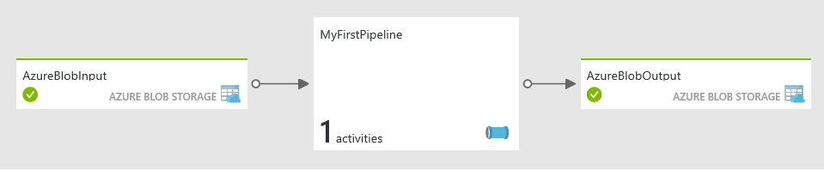

Simple ADF:
Business Goal: Transform and Analyze Web Logs each month
Design Process: Transform Raw Weblogs, using a Hive Query, storing the results in Blob Storage
Files ready for analysis and use in AzureML
HDInsight HIVE query to transform Log entries
Web Logs Loaded to Blob
Notes:
More options: Prepare System: https://azure.microsoft.com/en-us/documentation/articles/data-factory-build-your-first-pipeline-using-editor/ - Follow steps
Another Lab: https://azure.microsoft.com/en-us/documentation/articles/data-factory-samples/

Slide 14
2. Create the Data Factory
Portal, PowerShell and Visual Studio
Notes:
Setting Up: https://azure.microsoft.com/en-us/documentation/articles/data-factory-build-your-first-pipeline/

Slide 15
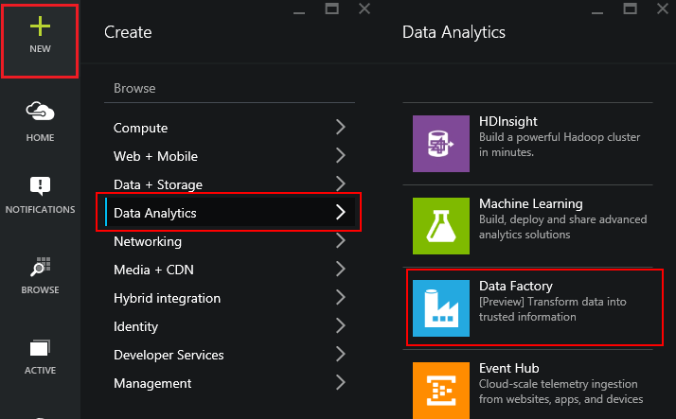
Using the Portal
Use in Non-MS Clients
Use for Exploration
Use when teaching or in a Demo
Notes:
Overview: https://azure.microsoft.com/en-us/documentation/articles/data-factory-build-your-first-pipeline/
Using the Portal: https://azure.microsoft.com/en-us/documentation/articles/data-factory-build-your-first-pipeline-using-editor/

Slide 16
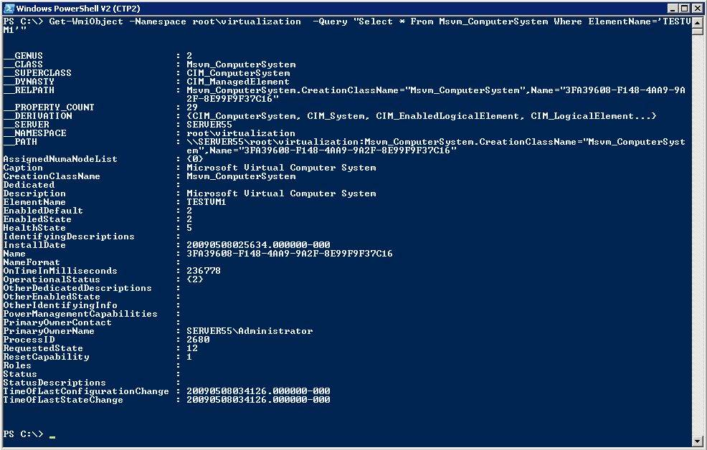
Using PowerShell
Use in MS Clients
Use for Automation
Use for quick set up and tear down
Notes:
Learning Path: https://azure.microsoft.com/en-us/documentation/articles/data-factory-introduction/
Full Tutorial: https://azure.microsoft.com/en-us/documentation/articles/data-factory-build-your-first-pipeline/

Slide 17
PowerShell ADF Example
New-AzureRmResourceGroup
-Name ADFTutorialResourceGroup
-Location "West US "
New-AzureRmDataFactory
-ResourceGroupName ADFTutorialResourceGroup
-Name FirstDataFactoryPSH
–Location "West US"
Register-AzureRmResourceProvider
-ProviderNamespace Microsoft.DataFactory
Get-AzureRmResourceProvider
Notes:
https://azure.microsoft.com/en-us/documentation/articles/data-factory-build-your-first-pipeline-using-powershell/

Slide 18
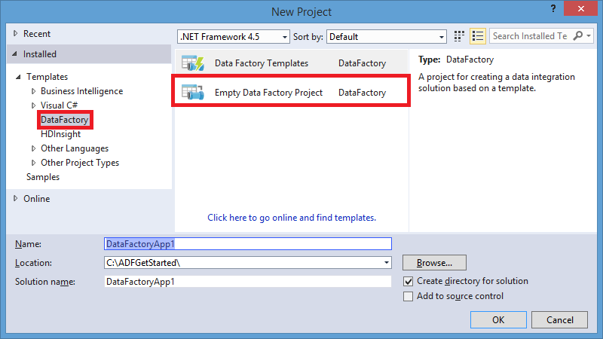
Using Visual Studio
Use in mature dev environments
Use when integrated into larger development process
Notes:
Overview: https://azure.microsoft.com/en-us/documentation/articles/data-factory-build-your-first-pipeline/
Using the Portal: https://azure.microsoft.com/en-us/documentation/articles/data-factory-build-your-first-pipeline-using-editor/

Slide 19
3. Create Linked Services
A Connection to Data or Connection to Compute Resource – Also termed “Data Store”
Notes:
Data Linking: https://azure.microsoft.com/en-us/documentation/articles/data-factory-data-movement-activities/
Compute Linking: https://azure.microsoft.com/en-us/documentation/articles/data-factory-compute-linked-services/

Slide 20


Data Options
Source | Sink
Blob | Blob, Table, SQL Database, SQL Data Warehouse, OnPrem SQL Server, SQL Server on IaaS, DocumentDB, OnPrem File System, Data Lake Store
Table | Blob, Table, SQL Database, SQL Data Warehouse, OnPrem SQL Server, SQL Server on IaaS, DocumentDB, Data Lake Store
SQL Database | Blob, Table, SQL Database, SQL Data Warehouse, OnPrem SQL Server, SQL Server on IaaS, DocumentDB, Data Lake Store
SQL Data Warehouse | Blob, Table, SQL Database, SQL Data Warehouse, OnPrem SQL Server, SQL Server on IaaS, DocumentDB, Data Lake Store
DocumentDB | Blob, Table, SQL Database, SQL Data Warehouse, Data Lake Store
Data Lake Store | Blob, Table, SQL Database, SQL Data Warehouse, OnPrem SQL Server, SQL Server on IaaS, DocumentDB, OnPrem File System, Data Lake Store
SQL Server on IaaS | Blob, Table, SQL Database, SQL Data Warehouse, OnPrem SQL Server, SQL Server on IaaS, Data Lake Store
OnPrem File System | Blob, Table, SQL Database, SQL Data Warehouse, OnPrem SQL Server, SQL Server on IaaS, OnPrem File System, Data Lake Store
OnPrem SQL Server | Blob, Table, SQL Database, SQL Data Warehouse, OnPrem SQL Server, SQL Server on IaaS, Data Lake Store
OnPrem Oracle Database | Blob, Table, SQL Database, SQL Data Warehouse, OnPrem SQL Server, SQL Server on IaaS, Data Lake Store
OnPrem MySQL Database | Blob, Table, SQL Database, SQL Data Warehouse, OnPrem SQL Server, SQL Server on IaaS, Data Lake Store
OnPrem DB2 Database | Blob, Table, SQL Database, SQL Data Warehouse, OnPrem SQL Server, SQL Server on IaaS, Data Lake Store
OnPrem Teradata Database | Blob, Table, SQL Database, SQL Data Warehouse, OnPrem SQL Server, SQL Server on IaaS, Data Lake Store
OnPrem Sybase Database | Blob, Table, SQL Database, SQL Data Warehouse, OnPrem SQL Server, SQL Server on IaaS, Data Lake Store
OnPrem PostgreSQL Database | Blob, Table, SQL Database, SQL Data Warehouse, OnPrem SQL Server, SQL Server on IaaS, Data Lake Store
Notes:
Data Movement requirements: https://azure.microsoft.com/en-us/documentation/articles/data-factory-data-movement-activities/
From on-premises, requires Data Management Gateway: https://azure.microsoft.com/en-us/documentation/articles/data-factory-move-data-between-onprem-and-cloud/

Slide 21
Activity Options
Transformation activity | Compute environment
Hive | HDInsight [Hadoop]
Pig | HDInsight [Hadoop]
MapReduce | HDInsight [Hadoop]
Hadoop Streaming | HDInsight [Hadoop]
Machine Learning activities: Batch Execution and Update Resource | Azure VM
Stored Procedure | Azure SQL
Data Lake Analytics U-SQL | Azure Data Lake Analytics
DotNet | HDInsight [Hadoop] or Azure Batch
Notes:
Main Document Site: https://azure.microsoft.com/en-us/documentation/articles/data-factory-data-transformation-activities/

Slide 22
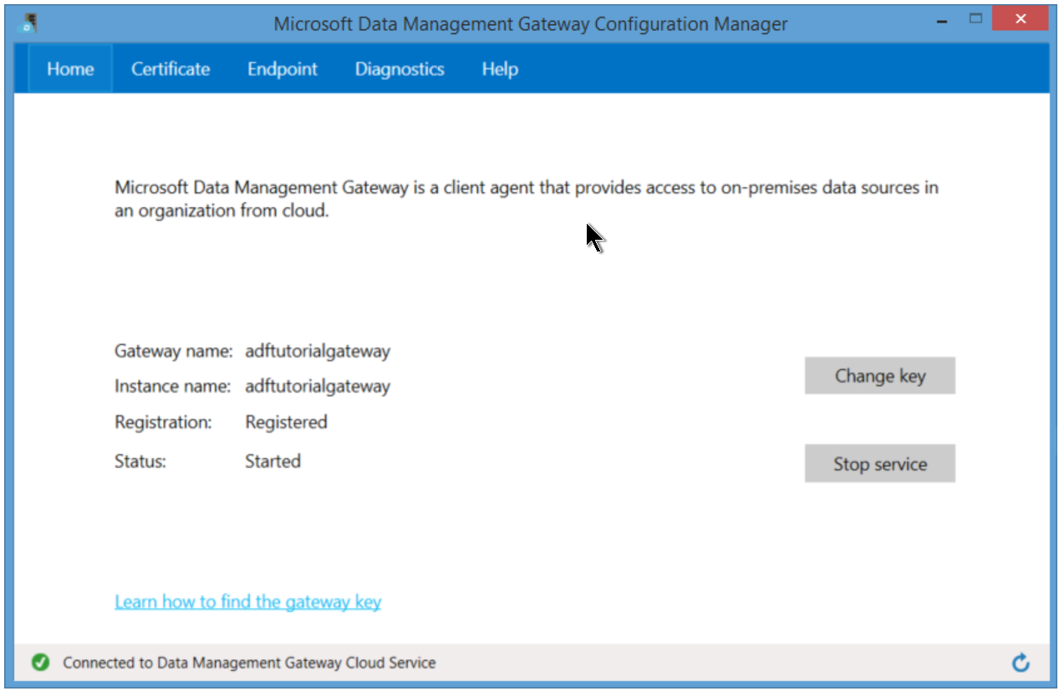
Gateway for On-Prem
Notes:
Activities: https://azure.microsoft.com/en-us/documentation/articles/data-factory-create-pipelines/
CreateHDICluster.txt:
{
"name": "HDInsightOnDemandLinkedService",
"properties": {
"type": "HDInsightOnDemand",
"typeProperties": {
"version": "3.1",
"clusterSize": 1,
"timeToLive": "00:30:00",
"linkedServiceName": "StorageLinkedService"
}
}
}

Slide 23
4: Create Datasets
Named reference or pointer to data
Notes:
Main Dataset Document Site: https://azure.microsoft.com/en-us/documentation/articles/data-factory-create-datasets/

Slide 24
Dataset Concepts
{
"name": "<name of dataset>",
"properties":
{
"structure": [ ],
"type": "<type of dataset>",
"external": <boolean flag to indicate external data>,
"typeProperties":
{
},
"availability":
{
},
"policy":
{
}
}.
Notes:
https://azure.microsoft.com/en-us/documentation/articles/data-factory-build-your-first-pipeline-using-editor/
AzureBlobOutput.txt:
{
"name": "AzureBlobOutput",
"properties": {
"type": "AzureBlob",
"linkedServiceName": "StorageLinkedService",
"typeProperties": {
"folderPath": "data/partitioneddata",
"format": {
"type": "TextFormat",
"columnDelimiter": ","
}
},
"availability": {
"frequency": "Month",
"interval": 1
}
}
}

Slide 25
5. Create Pipelines
Logical Grouping of Activities
Notes:
Main Pipeline Documentation: https://azure.microsoft.com/en-us/documentation/articles/data-factory-create-pipelines/

Slide 26
Pipeline Concepts
{
"name": "PipelineName",
"properties":
{
"description" : "pipeline description",
"activities":
[
],
"start": "<start date-time>",
"end": "<end date-time>"
}
}
Notes:
https://azure.microsoft.com/en-us/documentation/articles/data-factory-build-your-first-pipeline-using-editor/
Activities: https://azure.microsoft.com/en-us/documentation/articles/data-factory-create-pipelines/

Slide 27
6. Manage and Monitor
Scheduling, Monitoring, Disposition
Notes:
Main Concepts: https://azure.microsoft.com/en-us/documentation/articles/data-factory-monitor-manage-pipelines/

Slide 28
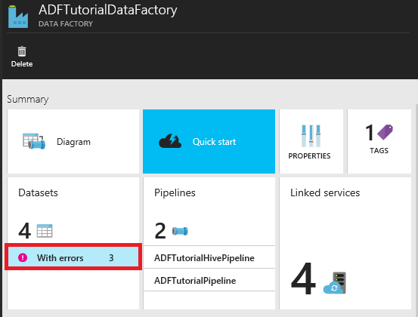
Locating Failures within a Pipeline
Notes:
PowerShell script to help deal with errors in ADF: http://blogs.msdn.com/b/karang/archive/2015/11/13/azure-data-factory-detecting-and-re-running-failed-adf-slices.aspx

Slide 29
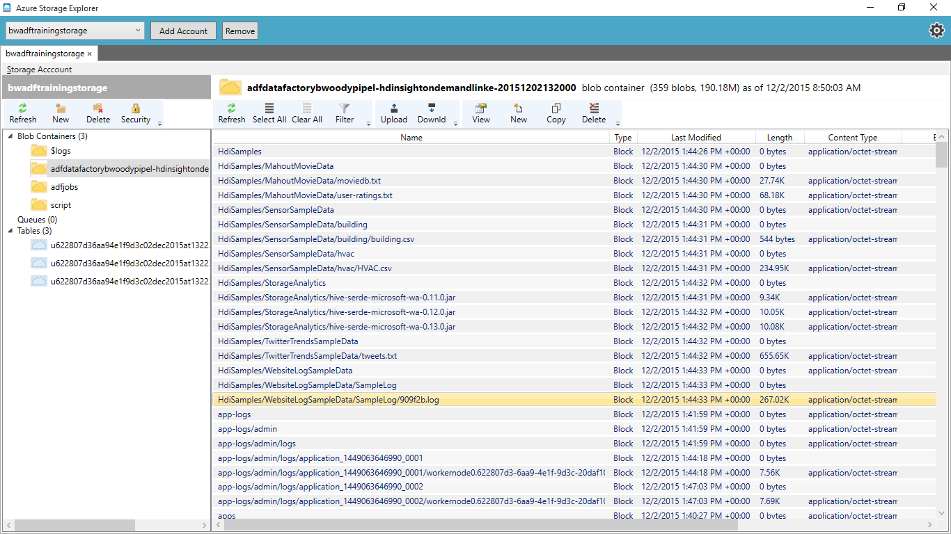
Notes:
PowerShell script to help deal with errors in ADF: http://blogs.msdn.com/b/karang/archive/2015/11/13/azure-data-factory-detecting-and-re-running-failed-adf-slices.aspx

Slide 30
Lab
Create and Run a Data Factory Implementation
Notes:
Open this site, and follow the steps listed there: https://azure.microsoft.com/en-us/documentation/articles/data-factory-build-your-first-pipeline/

Slide 31
What to use When
Notes:
Primary Site: https://azure.microsoft.com/en-us/services/data-factory/
2-minute overview video: https://channel9.msdn.com/Blogs/Windows-Azure/Introduction-to-Azure-Data-Factory/

Slide 32
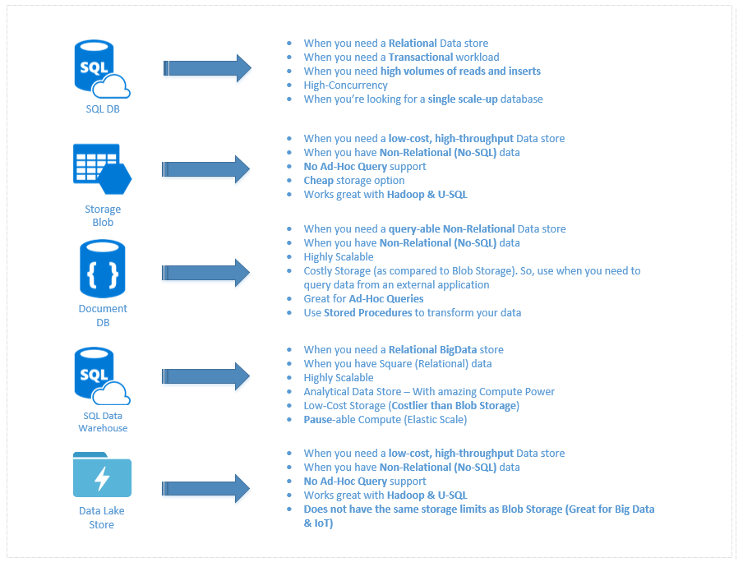
What to use for Data
Notes:
A discussion of this graphic: https://buckwoody.wordpress.com/2016/05/16/the-cortana-intelligence-suite-what-to-use-when/

Slide 33
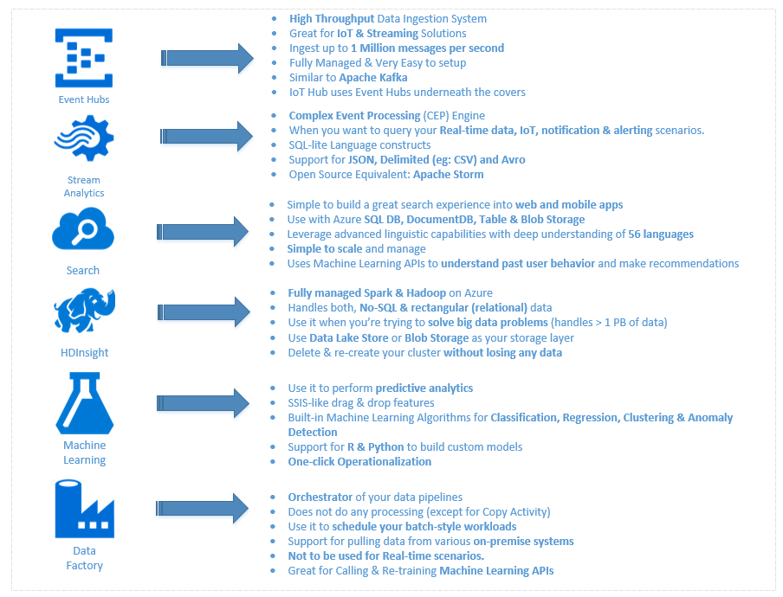
What to use for Compute
Notes:
A discussion of this graphic: https://buckwoody.wordpress.com/2016/05/16/the-cortana-intelligence-suite-what-to-use-when/

Slide 34
© 2016 Microsoft Corporation. All rights reserved. Microsoft, Windows, Microsoft Azure, and other product names are or may be registered trademarks and/or trademarks in the U.S. and/or other countries. The information herein is for informational purposes only and represents the current view of Microsoft Corporation as of the date of this presentation. Because Microsoft must respond to changing market conditions, it should not be interpreted to be a commitment on the part of Microsoft, and Microsoft cannot guarantee the accuracy of any information provided after the date of this presentation. MICROSOFT MAKES NO WARRANTIES, EXPRESS, IMPLIED OR STATUTORY, AS TO THE INFORMATION IN THIS PRESENTATION
Notes:
Additional Labs: https://github.com/microsoft/wingtiptickets

